Slide 1
Turbulence Analysis
Tingnan Hu, Peter Liu, Islina Shan, Ken Ye, Nancy Zhang

Slide 2

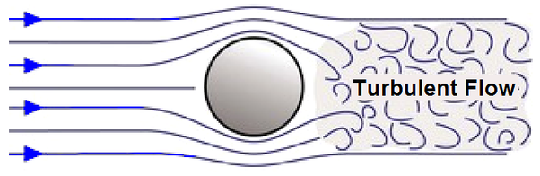


Introduction
Predictor Variables:
Reynolds number (Re)
Froud number / Gravitational acceleration (Fr)
Stokes number (St)
Response Variables:
Probability distribution for particle clusters split
Into four moments
Notes:
Turbulence is one of the fascinating topics in the research in fluid dynamics. It is characterized by its chaotic motion, rapid fluctuations and lack of predictable patterns. A better understanding and prediction of turbulent flow will help us gain a deeper insight into a wide range of applications, such as improved aerodynamics in airplane designs and better climatic modelling.
Re, which provides information on the type of flow a fluid is experiencing. Smaller value corresponds with laminar flow while larger values corresponds with turbulent flow
- Gravitational acceleration, `Fr`, which measures the gravitational forces particles are experiencing.
- Stokes number, `St`, where larger value corresponds with larger particle size.

Slide 3
Project Objectives
• Whether there exist a significant linear relationship between the predictors and the raw four moments
• Whether there exist any significant interaction effects between predictors on the response variables
• Whether a linear regression model suffice:
• Whether identified effects of the predictors vary for the four moments
Notes:
Range and distribution of predictors and response variables
Value of Re and Fr are concentrated in three and two values respectively. St is concentrated within the range of 0 to 1. For the four moments, the majority of values lie around 0, while the rest of the values are scattered evenly.

Slide 4
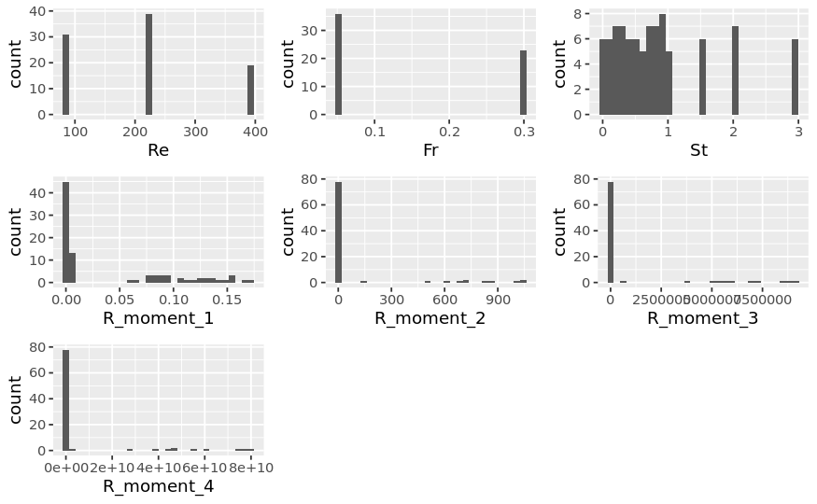
Exploratory Data Analysis
Notes:
Range and distribution of predictors and response variables
Value of Re and Fr are concentrated in three and two values respectively. St is concentrated within the range of 0 to 1. For the four moments, the majority of values lie around 0, while the rest of the values are scattered evenly.

Slide 5
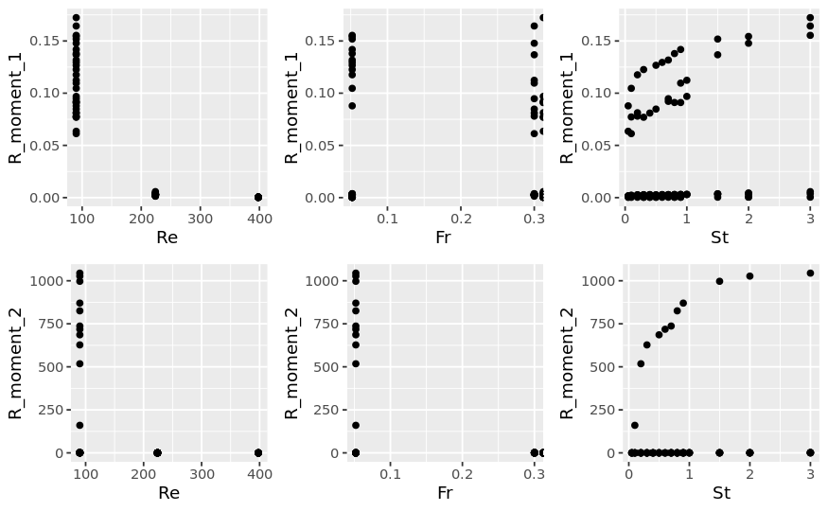
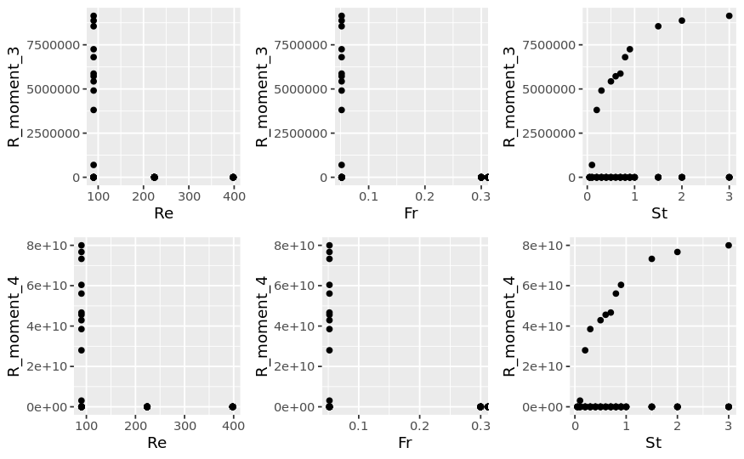
Exploratory Data Analysis
Notes:
We also explored how each of the predictors relate to the response using pairwise scatterplots. The distribution of the four moments with respect to Re and Fr is expected from our previous plot. It is worth noting that there appears to be a logarithmic relationship between the four moments and St.

Slide 6
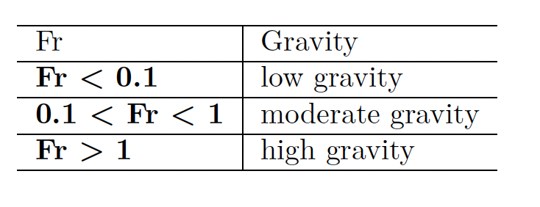
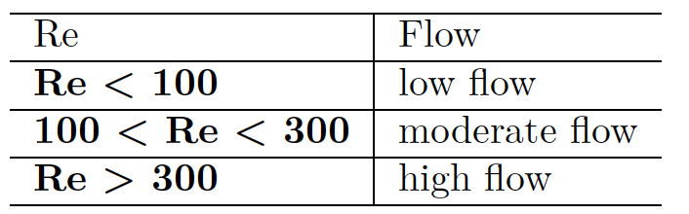
Simple Linear Regression
Step 1: Predictor Variable Transformation
Gravitational Acceleration (Fr)
Only 3 unique values
0.052
0.3
Inf
Infinity causes issue
Numerical -> Categorical
Reynolds number (Re)
Only 3 unique values
90
224
298
Numerical -> Categorical
Notes:
Now it’s time to explore some statistical models!
Before fitting our initial simple linear regression model, however, we decided to take a closer look at our predictor variables and make necessary adjustments.
We observed that the variable Fr only has three distinct values in both the training and the testing sets: 0.052, 0.3, and Infinity. Using these values as they are isn't practical, especially with Infinity in the mix. So, we decided to create a new categorical variable called "gravity." The bottom left figure shows this new categorization.
Similarly, we've noticed that the predictor variable Re also has only three unique values in both the training and the testing sets. To make it easier to fit our models, we created a new categorical variable called "flow," as shown in the bottom right figure.

Slide 7
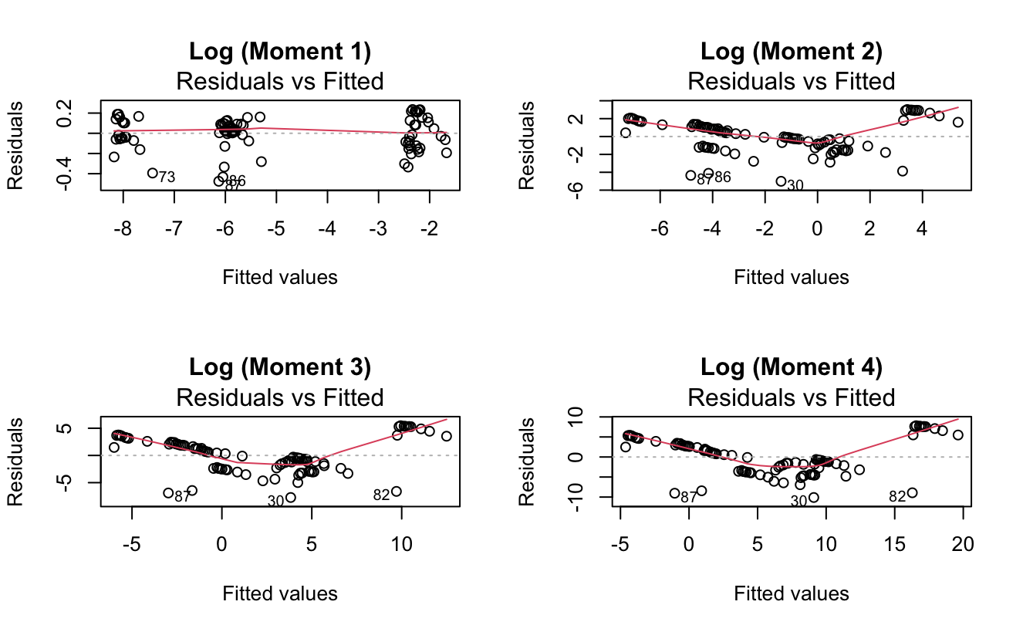
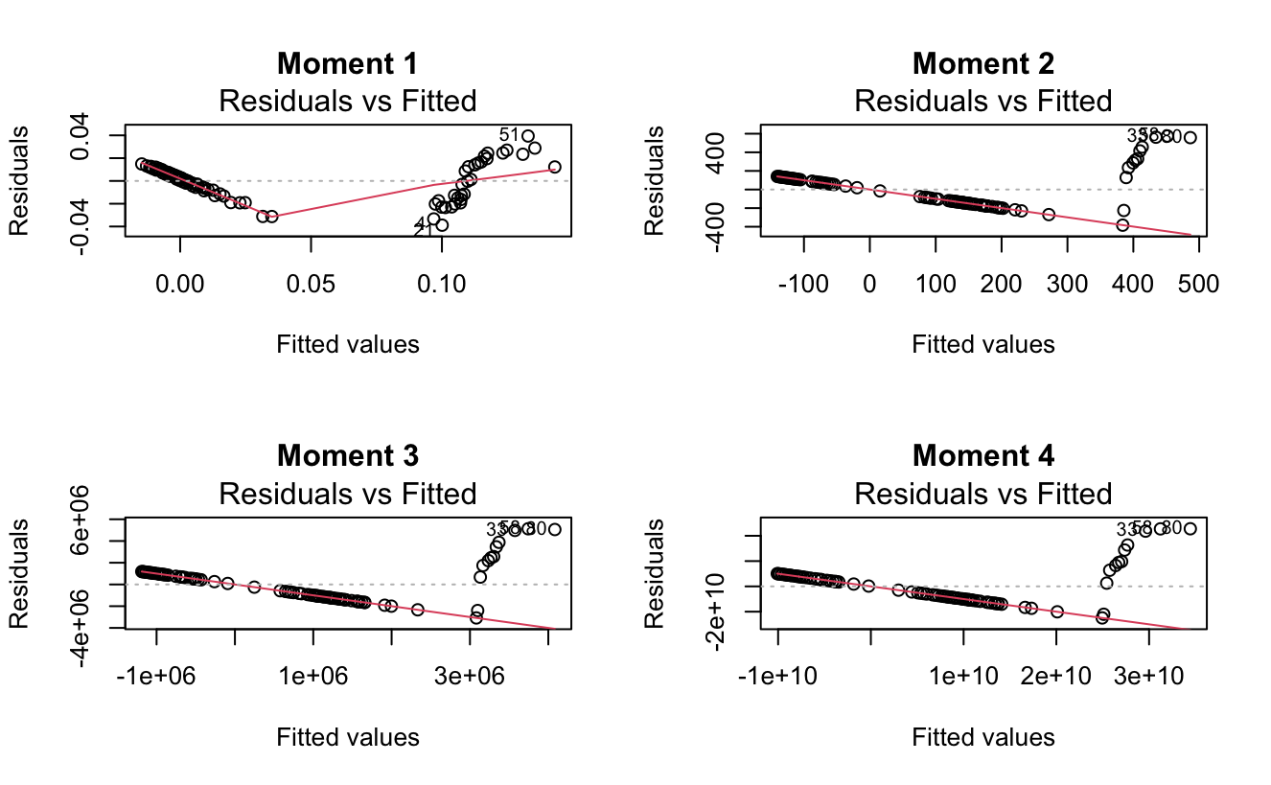
Simple Linear Regression (Cont.)
Step 2: Log-Transform Response Variables
Model: lm(R_moment ~ St + gravity + flow)
Adjusted R-squared
0.9251, 0.4175, 0.4023, 0.3906
Pattern in Residuals vs. Fitted plots
Violation of linearity
Model: lm(log(R_moment) ~ St + gravity + flow)
Adjusted R-squared
0.9949, 0.7633, 0.6802, 0.6518
Large improvement
Better Residuals vs. Fitted plots
Notes:
Now, we can start fitting some models!
Let's start with simple linear regression on the left. In all four models for moments 1 through 4, the p-values are all extremely low, suggesting a strong linear relationship between the predictors and the raw moments.
However, when we take a closer look at the Residuals vs Fitted plots, we notice clear patterns that indicate a violation of the linearity assumption.
To address this issue, we decided to log-transform the response variables. This not only results in more favorable residuals plots but also leads to improved adjusted R-squared values.

Slide 8
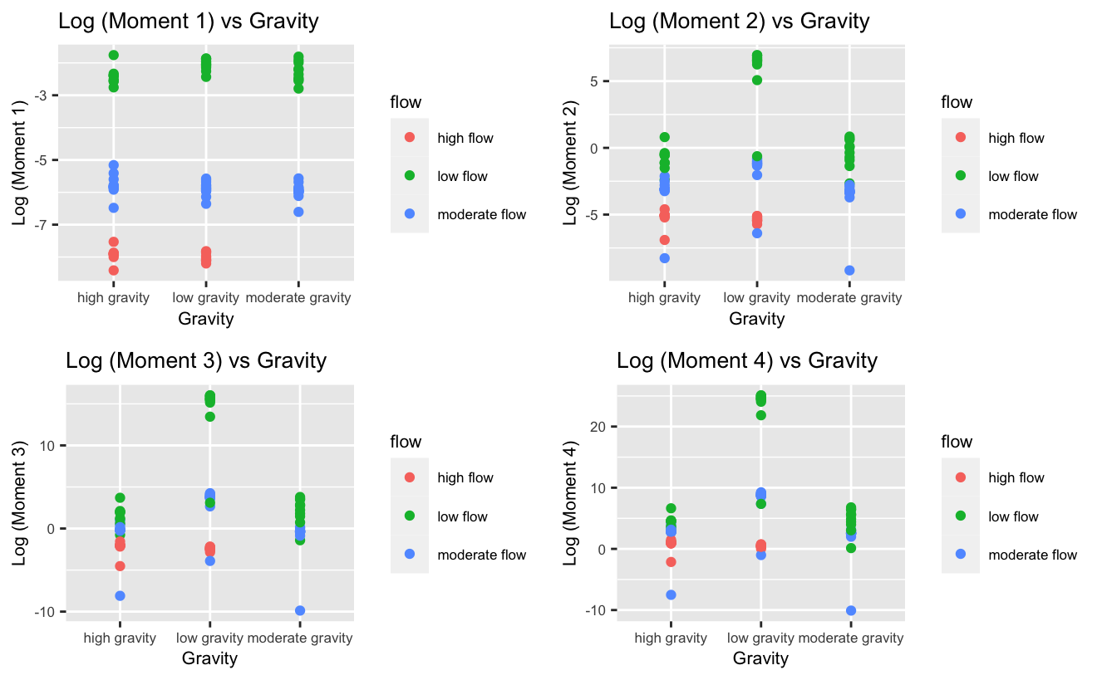
Simple Linear Regression (Cont.)
Step 3: Interaction Effect
Three possible interaction effects
gravity:flow
gravity:St
flow:St
Include gravity:flow
Slopes different (see left figure)
In new models for all 4 moments, interaction terms have significant p-values
Improved adjusted R-squared
0.9966, 0.8909, 0.8770, 0.8809
Notes:
We then explored potential interaction effects between our predictor variables. The plot on the left indicated a possible interaction between gravity and flow.
If we were to fit linear regression lines between gravity and the four moments for low, moderate, and high flow, we would observe different slopes.
To validate this assumption, we included the interaction term in our simple linear regression models, and this resulted in significant p-values for the interaction terms.
Our model fit also improved by including this interaction term. The adjusted R-squared values now stand at almost 100% for moment 1 and about 90% for moments 2 through 4.
Next, Peter is going to talk about the effects of including polynomial terms in our simple linear regression models.

Slide 9
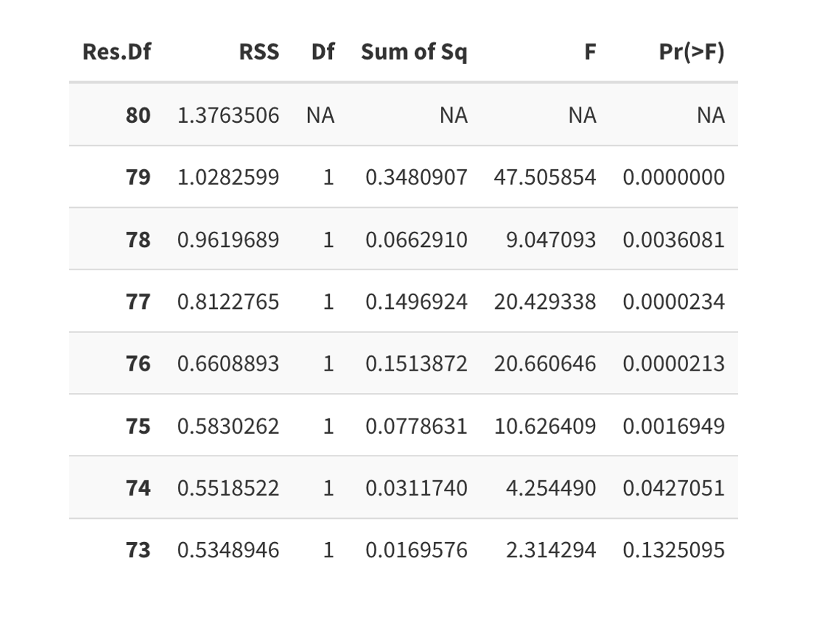
Simple Linear Regression (Cont.)
Step 4: Polynomial Term
•Considering Stokes number are relatively continuously distributed, we decide to explore higher degrees of stokes number in our model, on top of the interaction effect we just explored.
•Using analysis of variance of nested models, we discovered that up to eight degrees of stokes number are significant (except for the first moment, which only has up to 7 degrees of Stokes Number as significant terms)

Slide 10
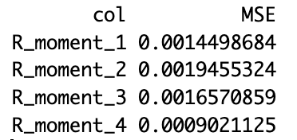
Ridge Regression
Method:
Cross Validation for parameter tuning
Predictive Performance
Split the original training dataset into 80% train set (~72 data points) and 20% test set
Conclusions
Moment 4 has the lowest mean squared error (MSE), and the other three response variables have comparable MSE.

Slide 11
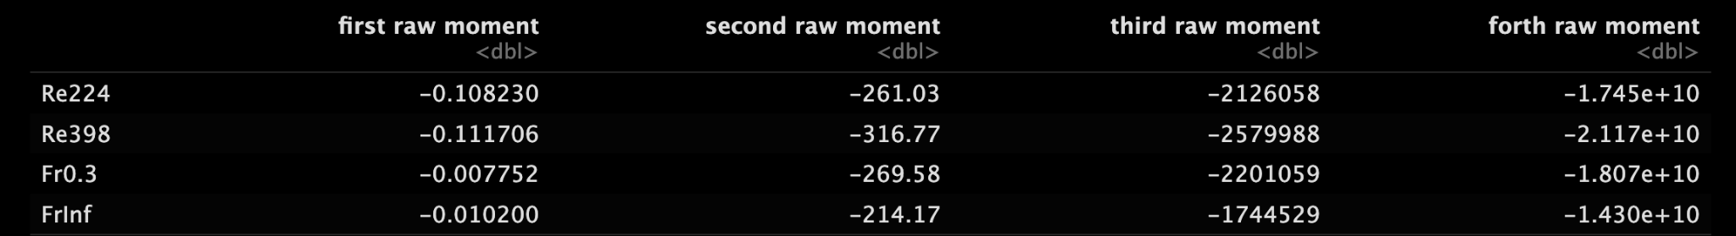
Splines
Method:
Find the degree of freedom by cross validation
Fit with natural spline models
Compare the estimate coefficients in each summary table
Scientific Inference
Categorical parameters Re, Fr, and Continuous parameter St have the largest effect on the forth raw moment
Consistency in the change (ratio) of four raw moments, transitions between the second and third moments (approximately 8150-fold change), between the third and fourth moments (approximately 8200-fold change)

Slide 12
Conclusion
Explore linear and nonlinear regression models, including simple linear regression, log-transformation, interactions, polynomial terms, ridge regression, and natural splines
Examine residual analysis, MSE, AIC, and BIC value
Predictive modeling:

Slide 13
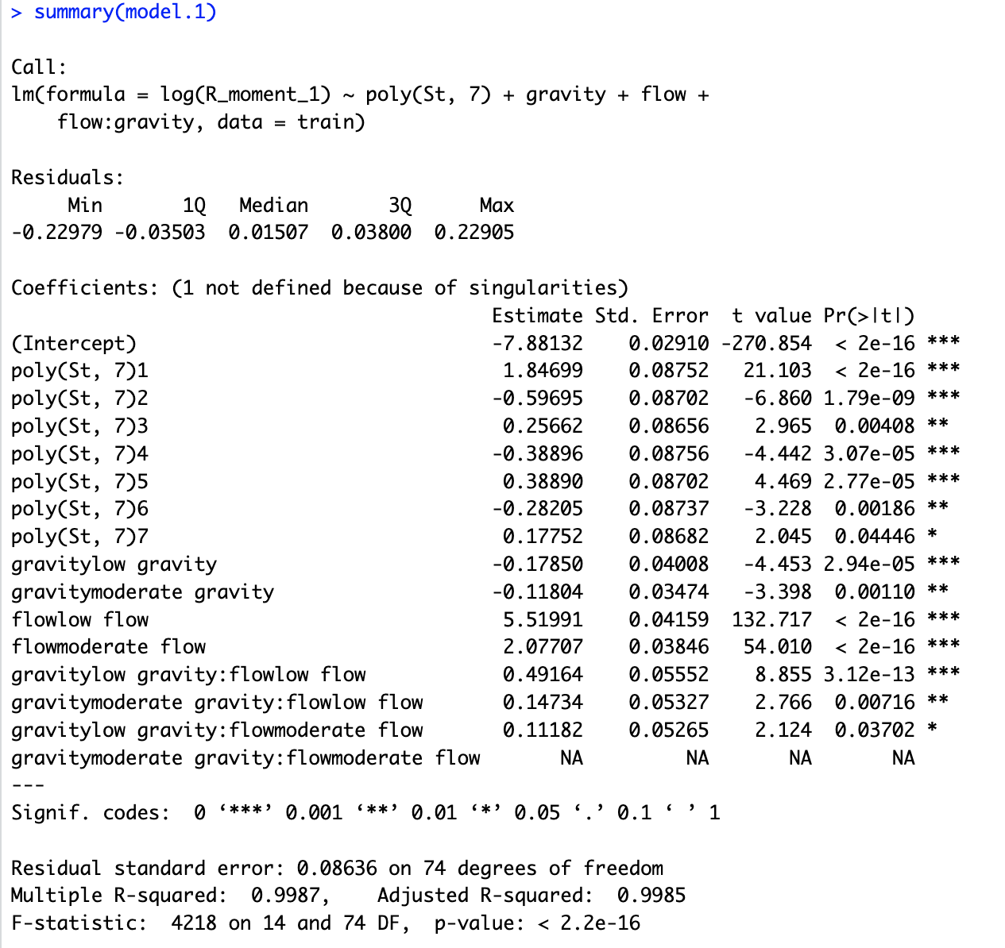
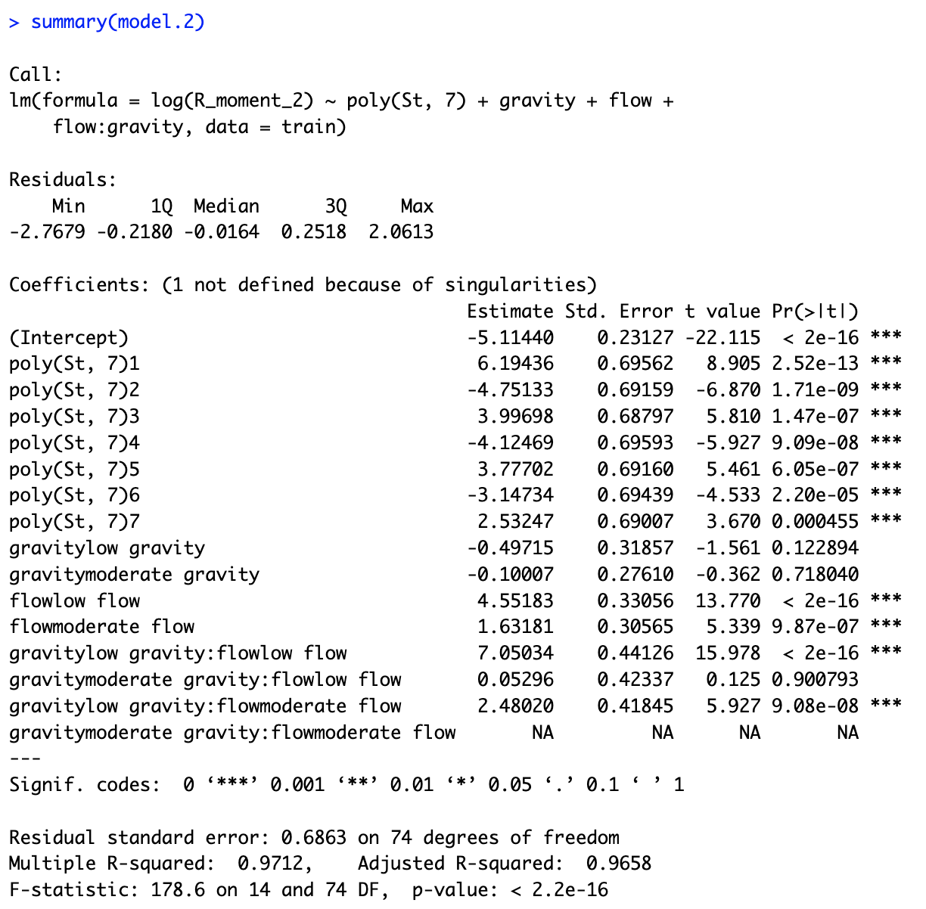
Final Model for First and Second Moment

Slide 14
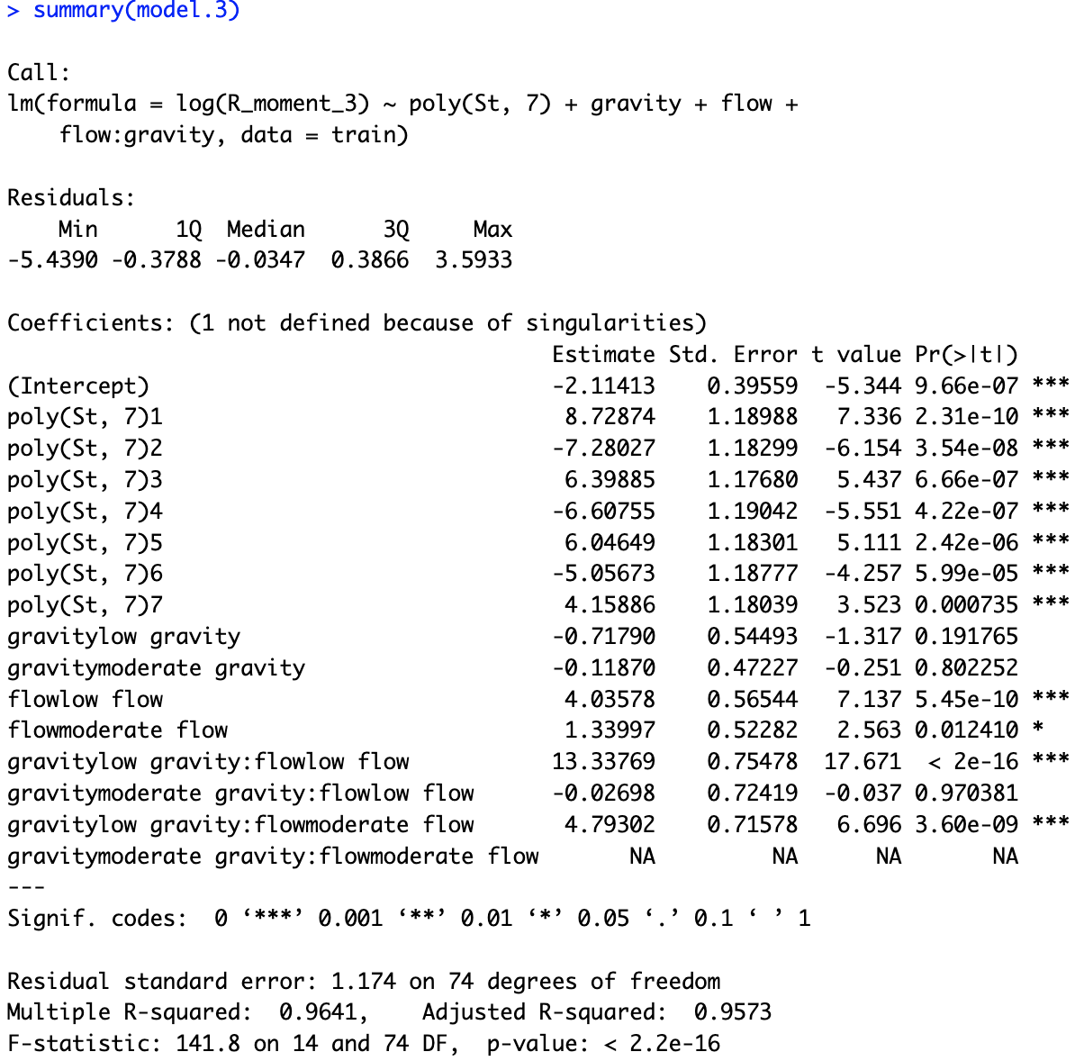
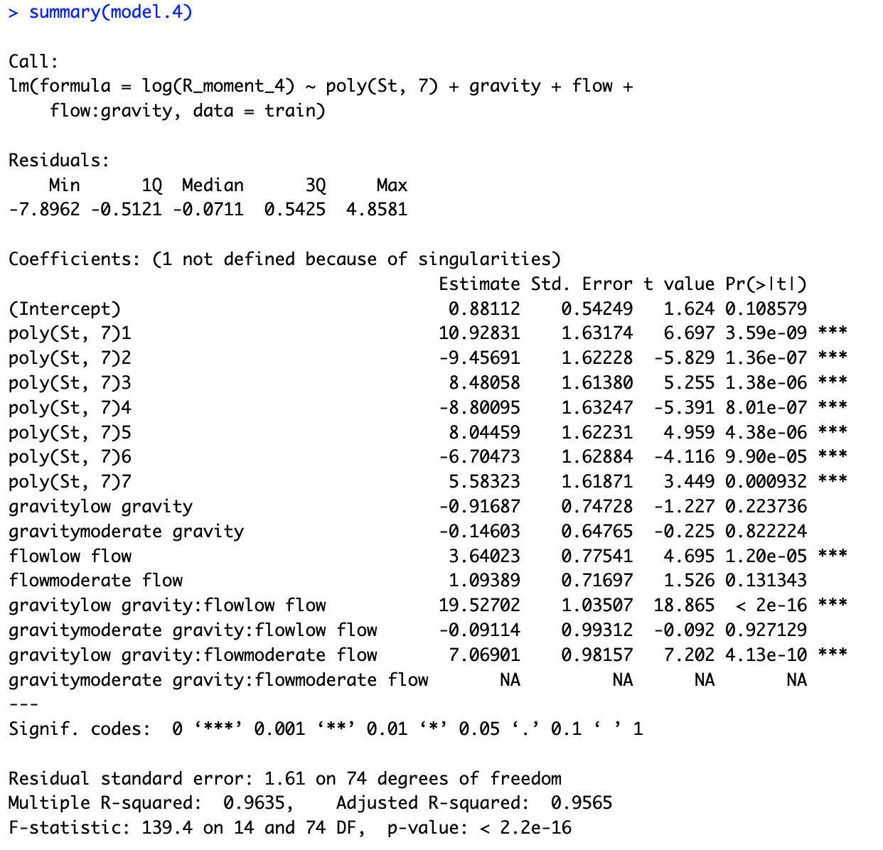
Final Model for Third and Fourth Moment

